Slide 1
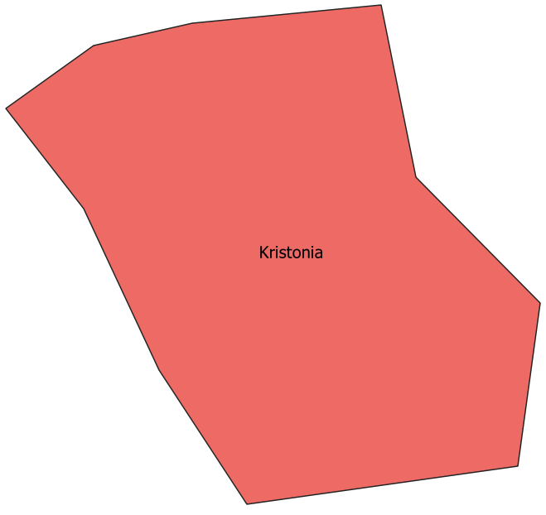
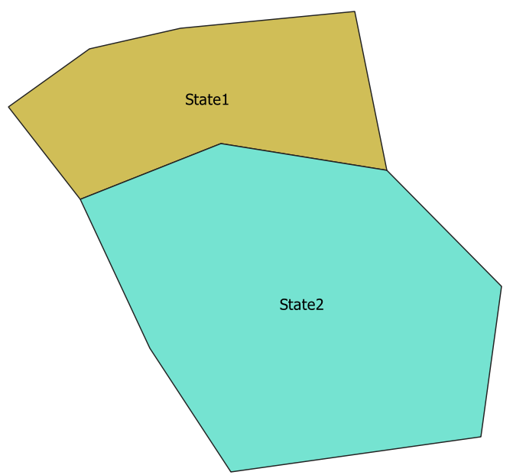
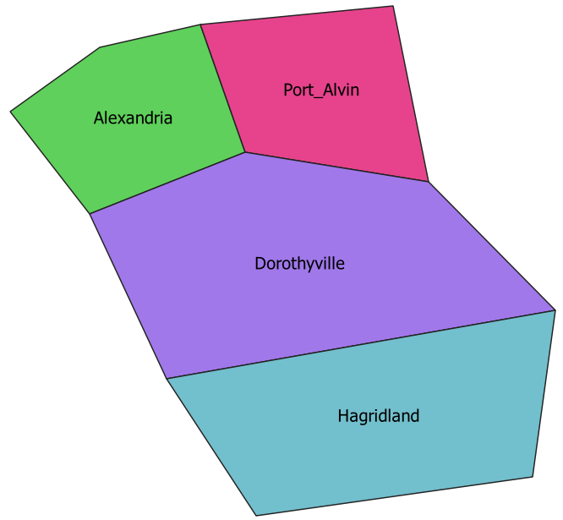
Kristonia
State 1
State 2
Alexandria
Port Alvin
Dorothyville
Hagridland
Level 0 (National)
Level 1
Level 2

